Slide 1

Open Data in Scottsdale

Slide 2
AGENDA
Introductions
Benefits of open data
Open Data Resolution
Open Data Governance
Progress and next steps

Slide 3

Notes:
Sunlight: nonprofit, nonpartisan organization that uses the tools of civic tech, journalism, and policy analysis to help make government more transparent and accountable.
Policy Team: Advocates for open data on the local, state, federal, and international levels.
State and Local team:
- formed in 2013
- Work on local policy team
- research best practices in open data
- provide guidance to cities seeking to open their data

Slide 4


Slide 5

BENEFITS OF OPEN DATA
Notes:
Don’t necessarily think we need this slide or the next

Slide 6
OPEN DATA IN SCOTTSDALE SHOULD BE...
Public | Published datasets live in the public domain.
Machine readable | Datasets are available in formats that computers can understand.
Timely | Datasets contain current information to encourage maximum use.
Accessible | Datasets are accessible to the broadest range of users to use for varying purposes.
Automated | When datasets are created or updated, they are automatically uploaded to relevant systems.

Slide 7
BENEFITS FOR INTERNAL USERS
Saves time
Creates opportunities for collaboration
Smarter decisions
Adds capacity

Slide 8
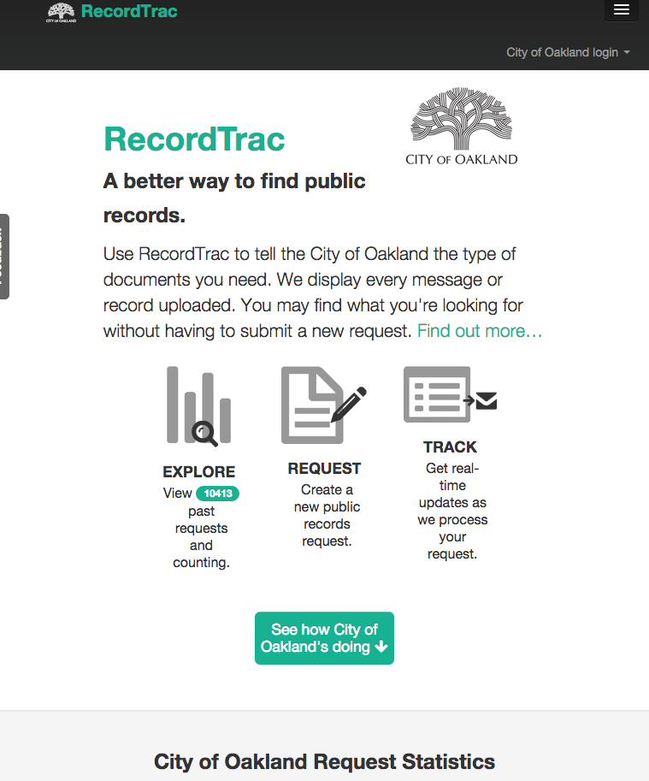
RecordTrac
As requests increased and became more complex, Oakland employees had difficulty fulfilling them
City implemented RecordTrac, a simple way to submit public records requests
Tool allows user to track requests
Displays previous records uploaded before prompting users to make new submissions
Notes:
Before opening its data, Oakland was struggling to fill public requests for information. Their software was not up-to-date and they simply did not have the capacity. The city worked with Code for America to develop RecordTrac, which allows users to easily submit requests for data. After data requests are filled, users can track requests and the information remains public, meaning requests for the same information won’t have to be filled again. Saves time + money

Slide 9
BENEFITS FOR EXTERNAL USERS
Easier access to up-to-date information
Nonprofits, academic institutions, media can use data to drive research
Create business opportunities
Increase transparency and accountability
Notes:
Empower citizens with data
Increase public participation in democratic process
Eliminates time spent requesting data, calling city, etc.

Slide 10

CITIGRAM
Created by CfA brigade in Charlotte
Uses open data to create a one-stop-shop for non-emergency events (foreclosures, new restaurants, etc.)
Expanding to cities nationwide
Notes:
-Created by CfA using Charlotte’s open data, this app is a one-stop-shop for all non-emergency events taking place in a particular location. Users can type in their location and see various notifications about what’s going on around them, such as a foreclosure or building notification filing . Other cities are starting to implement it, including Raleigh, Louisville, and NYC

Slide 11
OPEN DATA RESOLUTION
Notes:
Don’t necessarily think we need this slide or the next

Slide 12
WHY AN OPEN DATA POLICY?
Policy maximizes potential
Structure: clarifies internal responsibilities
Accountability: creates accountability for data quality
Sustainability: ensures sustained commitment
Participation: creates a regular, official space for public participation

Slide 13
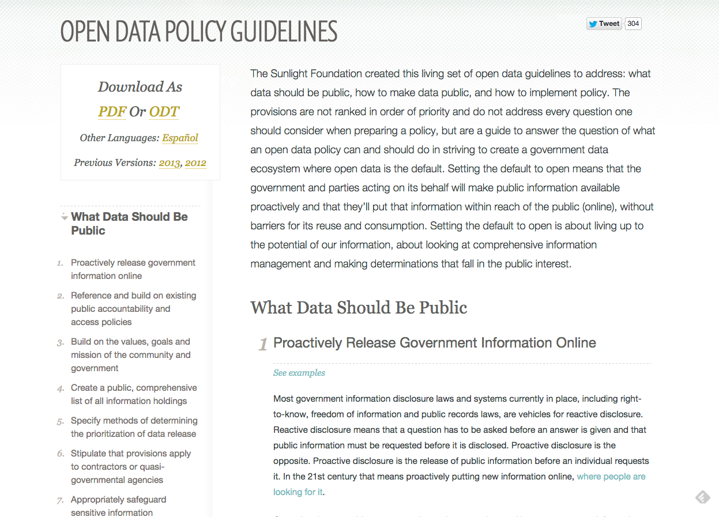

SUNLIGHT’S OPEN DATA POLICY GUIDELINES
31 provisions in our guidelines spelling out:
What data should be made public
How to make data public
How to implement policy
Notes:
We want to see all governments of all sizes achieving these kinds of benefits. To help empower governments to start their own open data programs, we created the open data policy guidelines, which compile best practices to serve as a guide through the questions that exist around addressing how to open up and release information. These guidelines, originally crafted in 2012, have gone through several iterations since then as we continue to learn about and refine best practices to achieve the full range of benefits for governments and the public.
There are more than 31 provisions in our Guidelines, sorted into three buckets:
what data should be public
how to make data public
And how to implement policy.

Slide 14
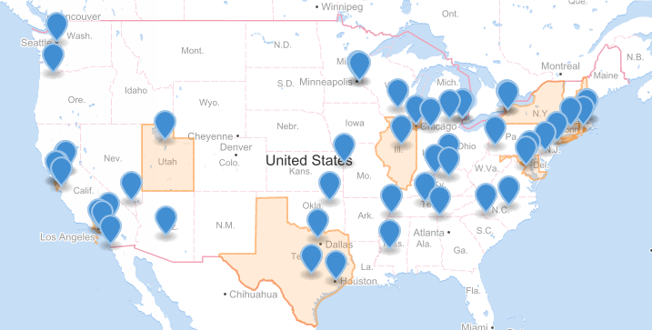
OPEN DATA POLICIES- JULY 2016
Notes:
Nearly 60 open data policiesin cities across the country

Slide 15
SCOTTSDALE’S OPEN DATA RESOLUTION
Establishes open data program
Makes public information open by default
Establishes an Open Data Portal
Requires a report and review
Safeguards sensitive information
Creates a process for developing open data governance

Slide 16
OPEN DATA GOVERNANCE
Notes:
Don’t necessarily think we need this slide or the next

Slide 17
WHAT DO WE MEAN BY DATA GOVERNANCE?
Vision
People:
Leadership
Data coordinators
Community
Sustainable process

Slide 18
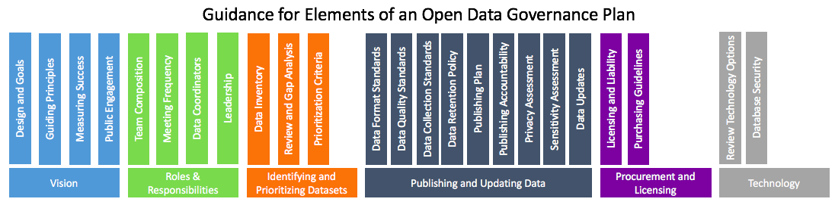
COMPONENTS OF A GOVERNANCE GUIDE
Notes:
Empower citizens with data
Increase public participation in democratic process
Eliminates time spent requesting data, calling city, etc.

Slide 19
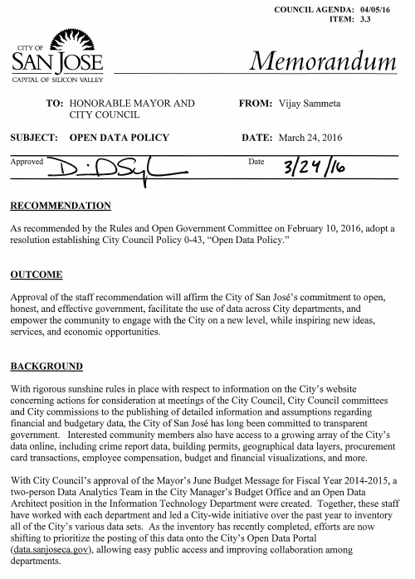
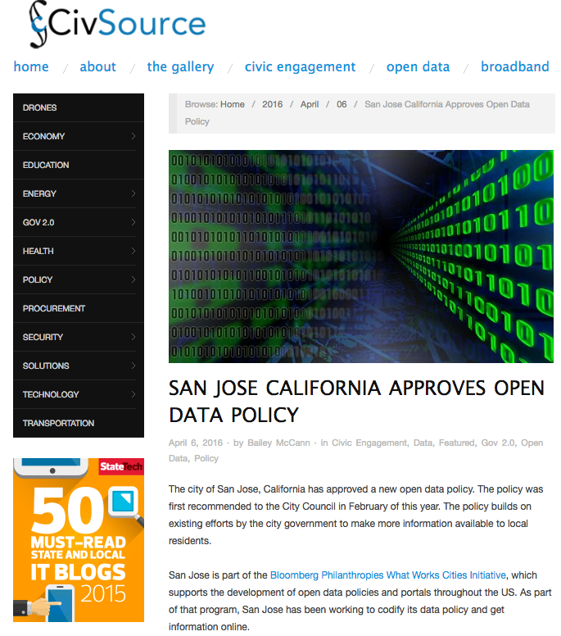
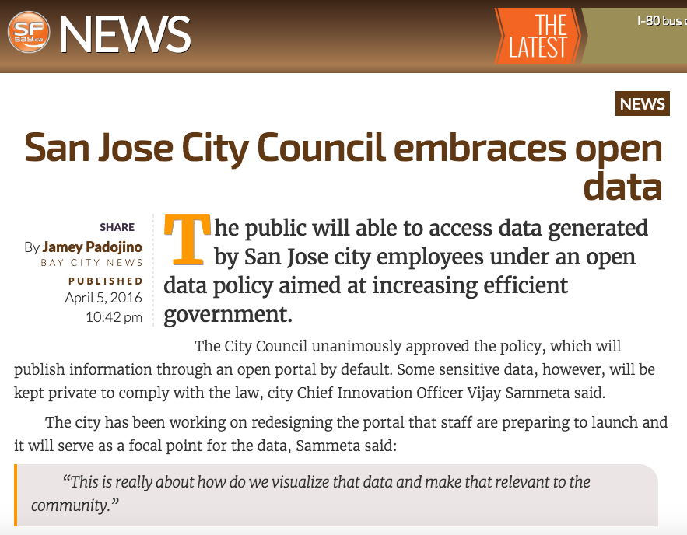
EXAMPLE: SAN JOSE, CA
Notes:
What was an internal effort to collect useful data became a public commitment to open government data by default
Building on earlier drafts and leveraging the relationships with departments build through the data inventory, the city manager and mayor’s offices worked with WWC to develop an open data policy
The city manager could have signed an executive order, but the leadership wanted to maximize impact and sustainability by seeking unanimous approval from the city council on april 6.

Slide 20
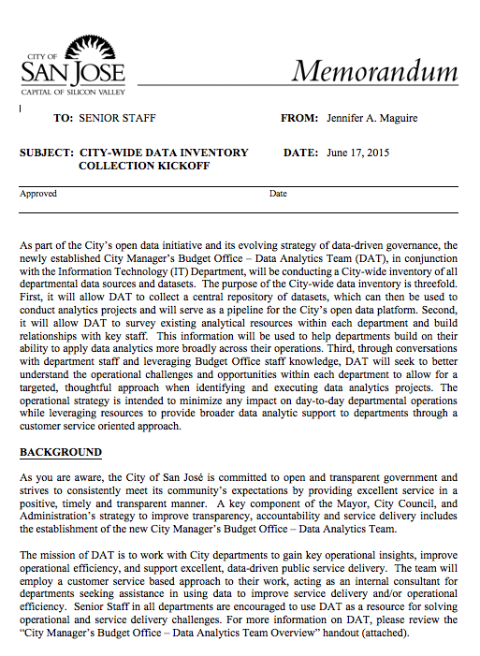

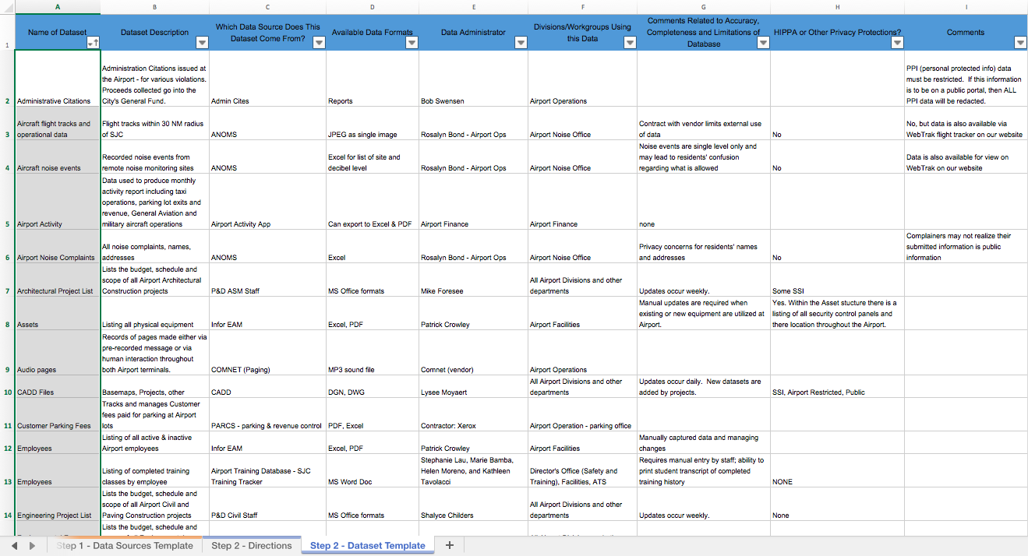
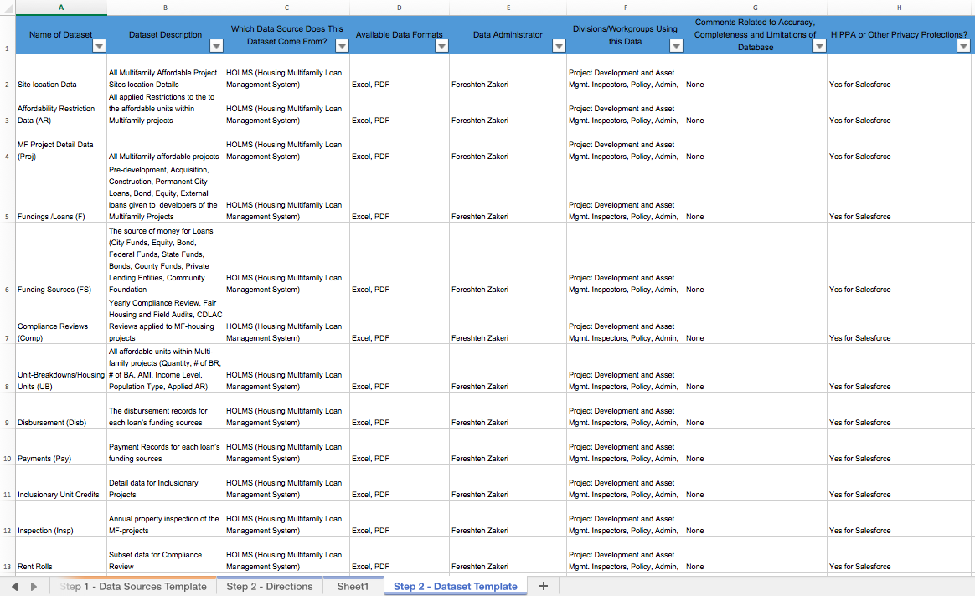
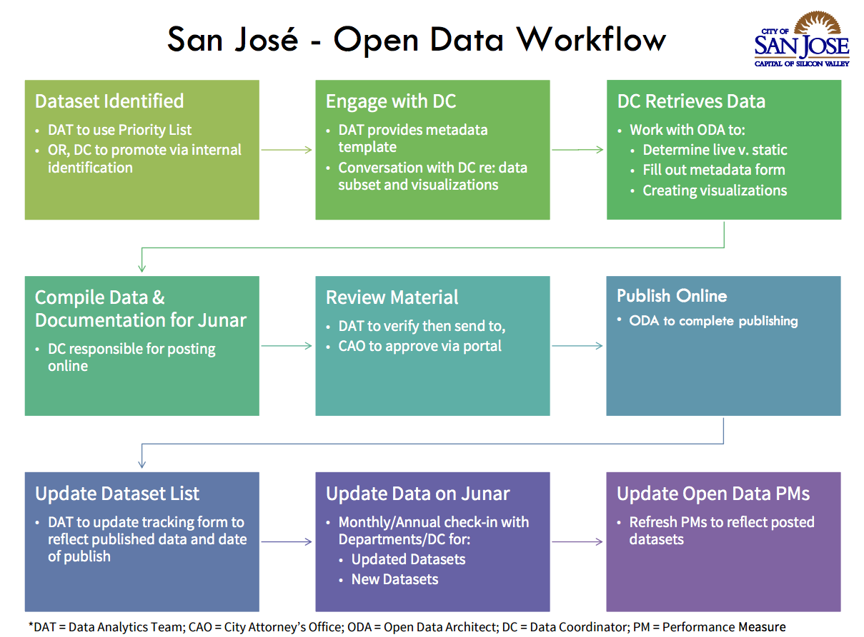
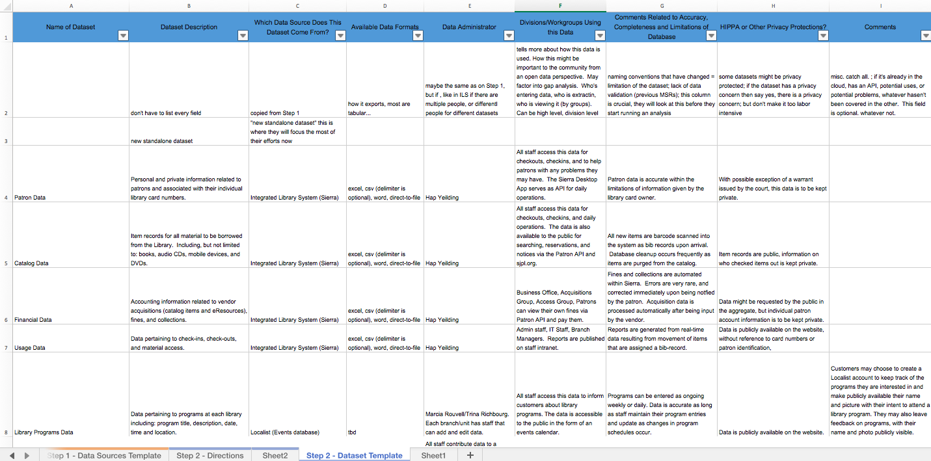
EXAMPLE: SAN JOSE, CA
Notes:
Inventory and Governance
CSJ’s DAT went door to door, meeting with each department to talk about its data and work with them on creating a dataset inventory
By listening to each department’s challenges, and always looking for ways to collaborate with staff to help them achieve a goal, the DAT build strong relationships with most of the city’s departments
What could have been a chore for departments, turned into an opportunity to share perspectives on data collection, storage, and use
The city’s dataset inventory grew from just a few to over 600 datasets
DAT is also holding prioritization conversations with all departments
CSJ is bringing the community into the prioritization discussion as well and setting expectations about CSJ data with residents, business owners, and other partners
Impact: CSJ is elevating the use of data as an asset, both internally and externally by establishing clear guidelines and processes
Governance
With over a dozen departments and over 600 datasets in the inventory, it was essential that San Jose create an internal governance framework for sustaining the flow of open data onto the portal in the future
CSJ created a policy review committee that included department directors, the city manager’s office, and the Mayor’s Innovation team to solicit input from departments and shephard the policy through government
A subset of this group also ensures a sustained open data program
Designing and implementing a prioritization approach
Clarifying the flow of data from departmental data coordinator to open data portal release
Addressing any challenges that present in the future
As a result of this approach, dozens of new datasets have been released to the portal, which now includes: 911 calls, affordable housing data, permitting, traffic, fire incidents, and other priority areas.

Slide 21
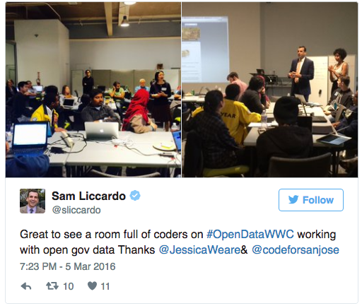
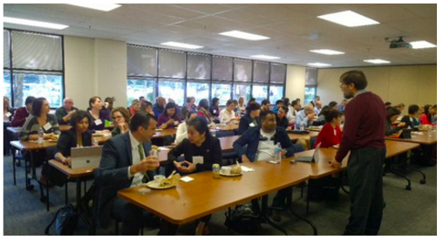
EXAMPLE: SAN JOSE, CA
Notes:
San Jose is home to one of the most vibrant tech communities in the country and the city wants to do a better job of engaging this community to solve problems and to make sure that the city’s open data program is responsive to their requests.
International Open Data Day on March 5
City government participated in the Code for San Jose Open Data Jam, including the DAT, Mayor’s Office, and the Mayor himself
More than 40 people from the community participated and worked on a collection of projects, including:
Analysis of over 100 years of San Jose building permit data, including geotagging and cleaning all the data
Developing dashboards to help the public connect with city data better, inspired by the How’s Business dashboard designed by civic hackers in Chicago
Developing a user friendly garbage app driven by open data
Plus brigade working on site to capture CSJ progress on releasing open data with metrics, like SF Progress
Open Data Governance and Engagement (Lena)
Community engagement
CSJ took an inclusive approach to engaging the community in its open data program (e.g., 3 separate meetings with business, nonprofit, and education partners to discuss open data policy and types of data these groups would be interested)
Impact: CSJ is setting up a mechanism for success and engendering trust with the community through its open data program

Slide 22
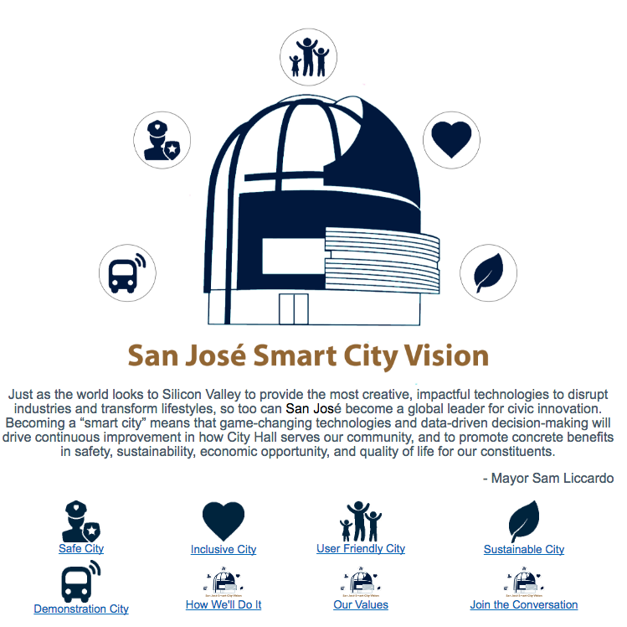
EXAMPLE: SAN JOSE, CA
Data Analytics Team
Open Data
Policy and Program
Smart City Vision
Advanced Analytics Projects
Notes:
Smart City initiative
“Becoming a “smart city” means that game-changing technologies and data-driven decision-making will drive continuous improvement in how City Hall serves our community, and to promote concrete benefits in safety, sustainability, economic opportunity, and quality of life for our constituents.” Mayor Sam Liccardo
Open data and data driven decisionmaking brought under the umbrella of a broader, council-approval smart city vision
We see this as success in merging open data, internal data, performance analytics, and evidence based policy making together
Just yesterday, CSJ further committed to this effort with the announcement of a new Office of Civic Innovation in the City Manager’s office:
A new deputy city manager position to oversee the smart cities effort, Kip Harkness who was formerly director of technology engagement at PayPal
And a director of civic innovation and digital strategies, Steven DiNoto, formerly a senior manager at Amazon
- Provides the umbrella for furthering this work in a sustainable and resourced way
DAT was always analytics
But now there is a foundation of inventoried data, a Smart City umbrella, recognition from the city council, leadership from the Mayor’s Office and City Manager’s Office, and a ever stronger relationship with the CSJ community
DAT has set its sights on:
Code enforcement
Vision Zero
Animal Care Services
Housing and homelessness
Illegal Dumping
And we are hoping to help them advance their work even further

Slide 23
PROGRESS SO FAR:
SAP Public Data Resources Survey
Open Data Resolution
Data inventory
Notes:
SAP public data resources survey
Resolution passed August 31 (can talk about why sunlight’s guidelines were created/importance)
Inventory- almost 100 datasets, is this correct? - revitalization focus

Slide 24
NEXT STEPS
Administrative order
Portal

Slide 25
DISCUSSION QUESTIONS

